Slide 1
Mori Seiki Update
Kyle Williams
Georgia Institute of Technology
Atlanta, Georgia USA
August 8, 2019
Notes:
Good afternoon, and other greetings.

Slide 2
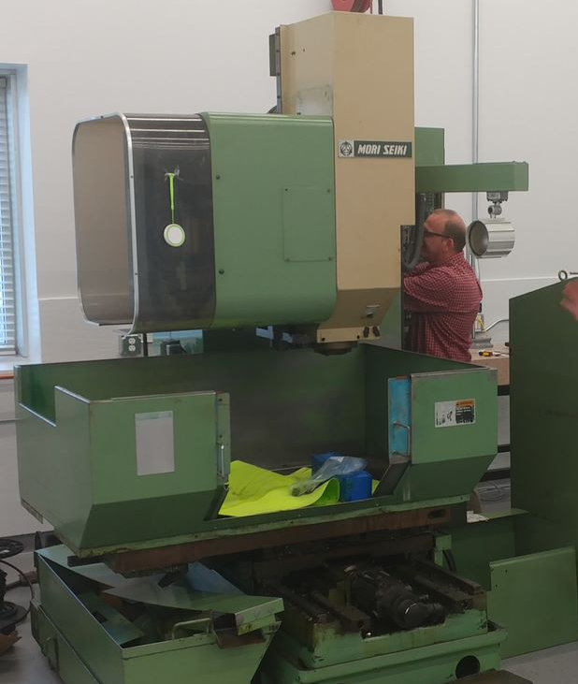
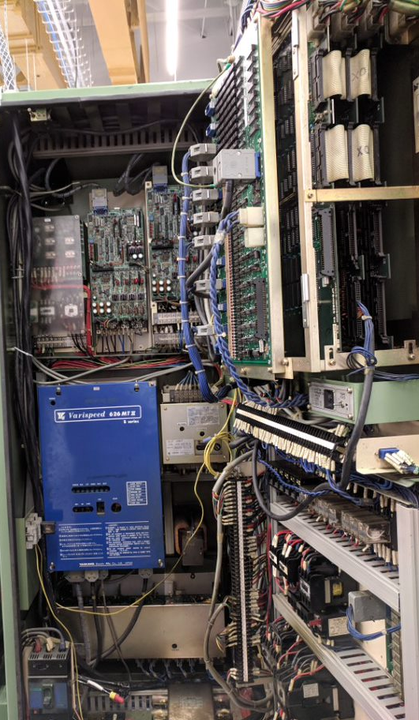
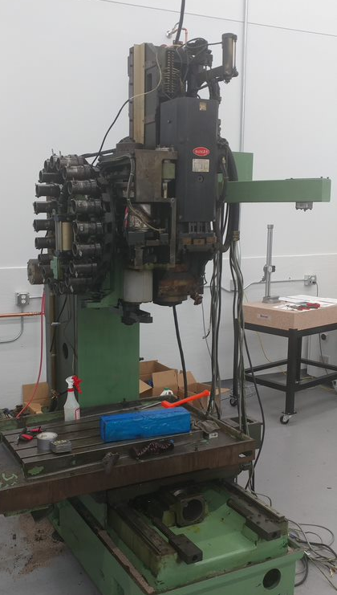
Introduction
1986 CNC mill
Control cabinet
Bare bones

Slide 3
Goals
Update Package
Inexpensive
Flexible software
Open communication
Higher level control and monitoring software

Slide 4
Subsystem Overview
Software
Electrical
Mechanical
High Level Control
Positioning
Coolant
+
Lubricant
Circuit Level Control
+
Power Distribution
3 Phase Power
+
Compressed air
Spindle
Tool Changer

Slide 5
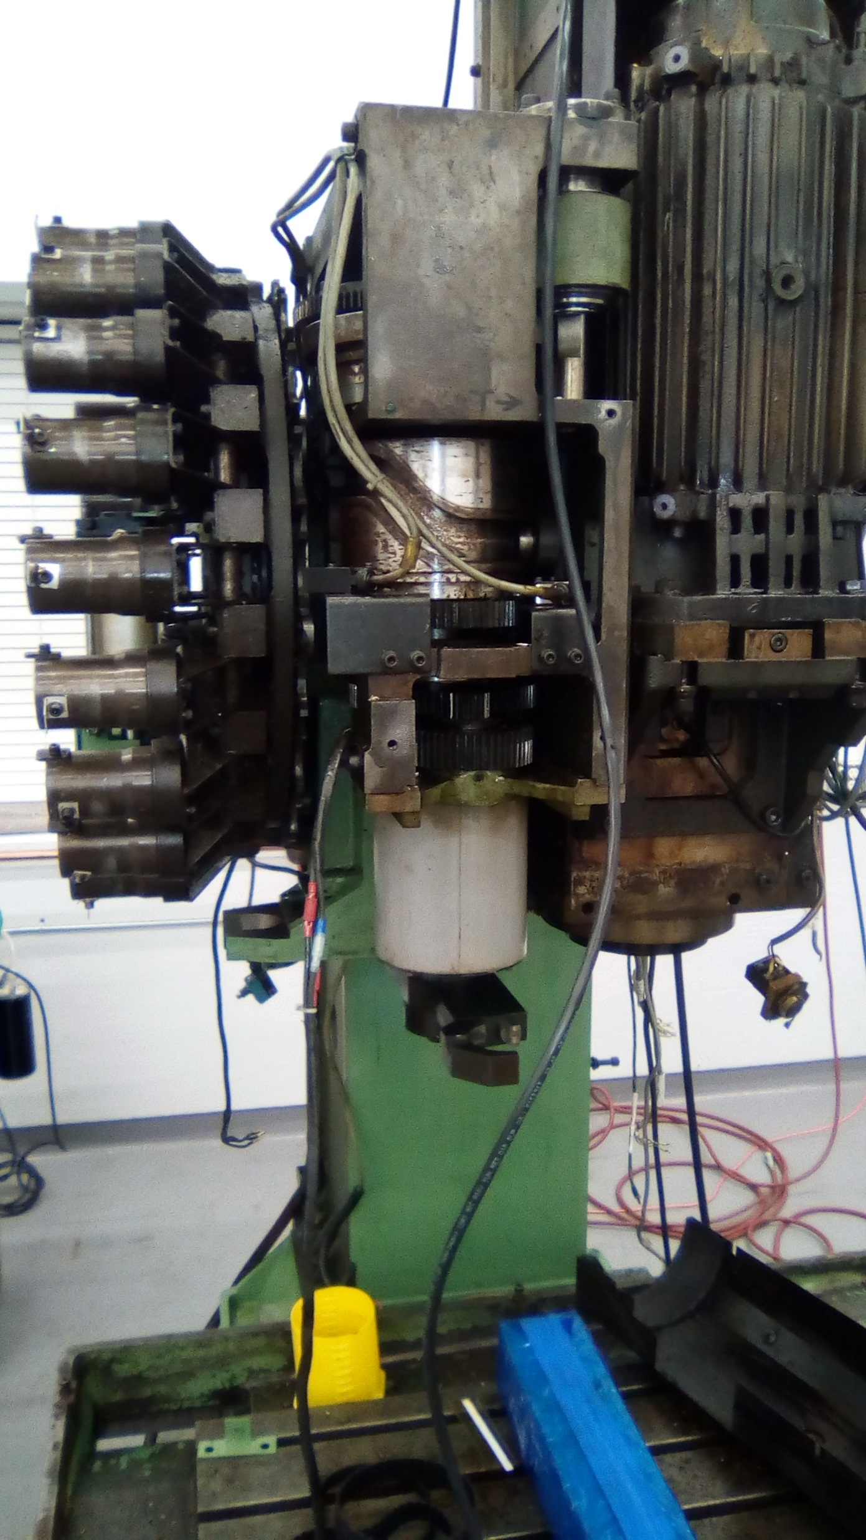
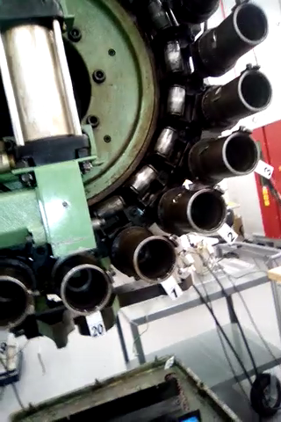
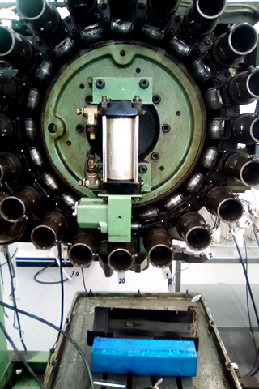
Tool Changer
Complete system
Tool magazine
Pneumatic piston

Slide 6
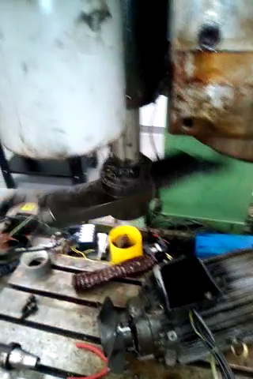
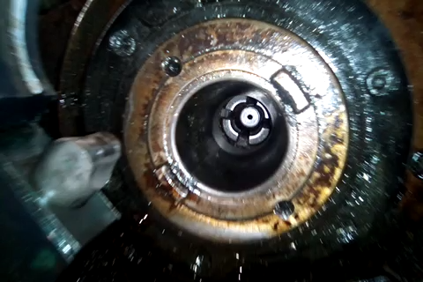
Tool Changer
Complete system
Tool change arm
Tool clamp

Slide 7
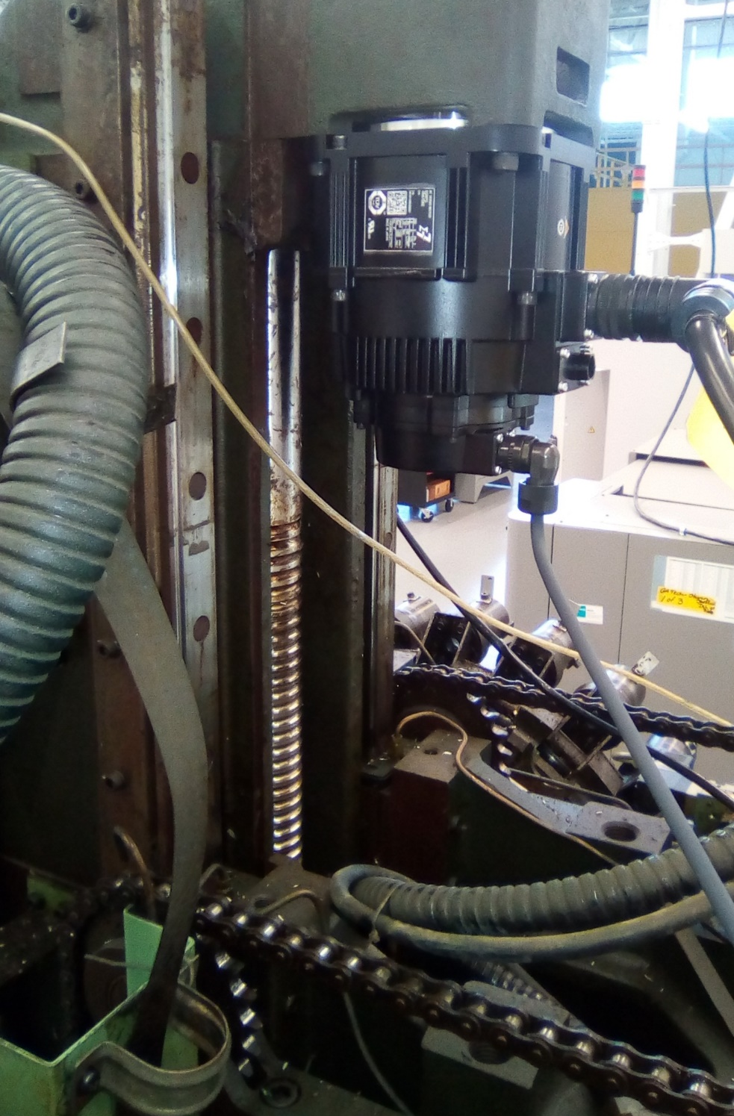
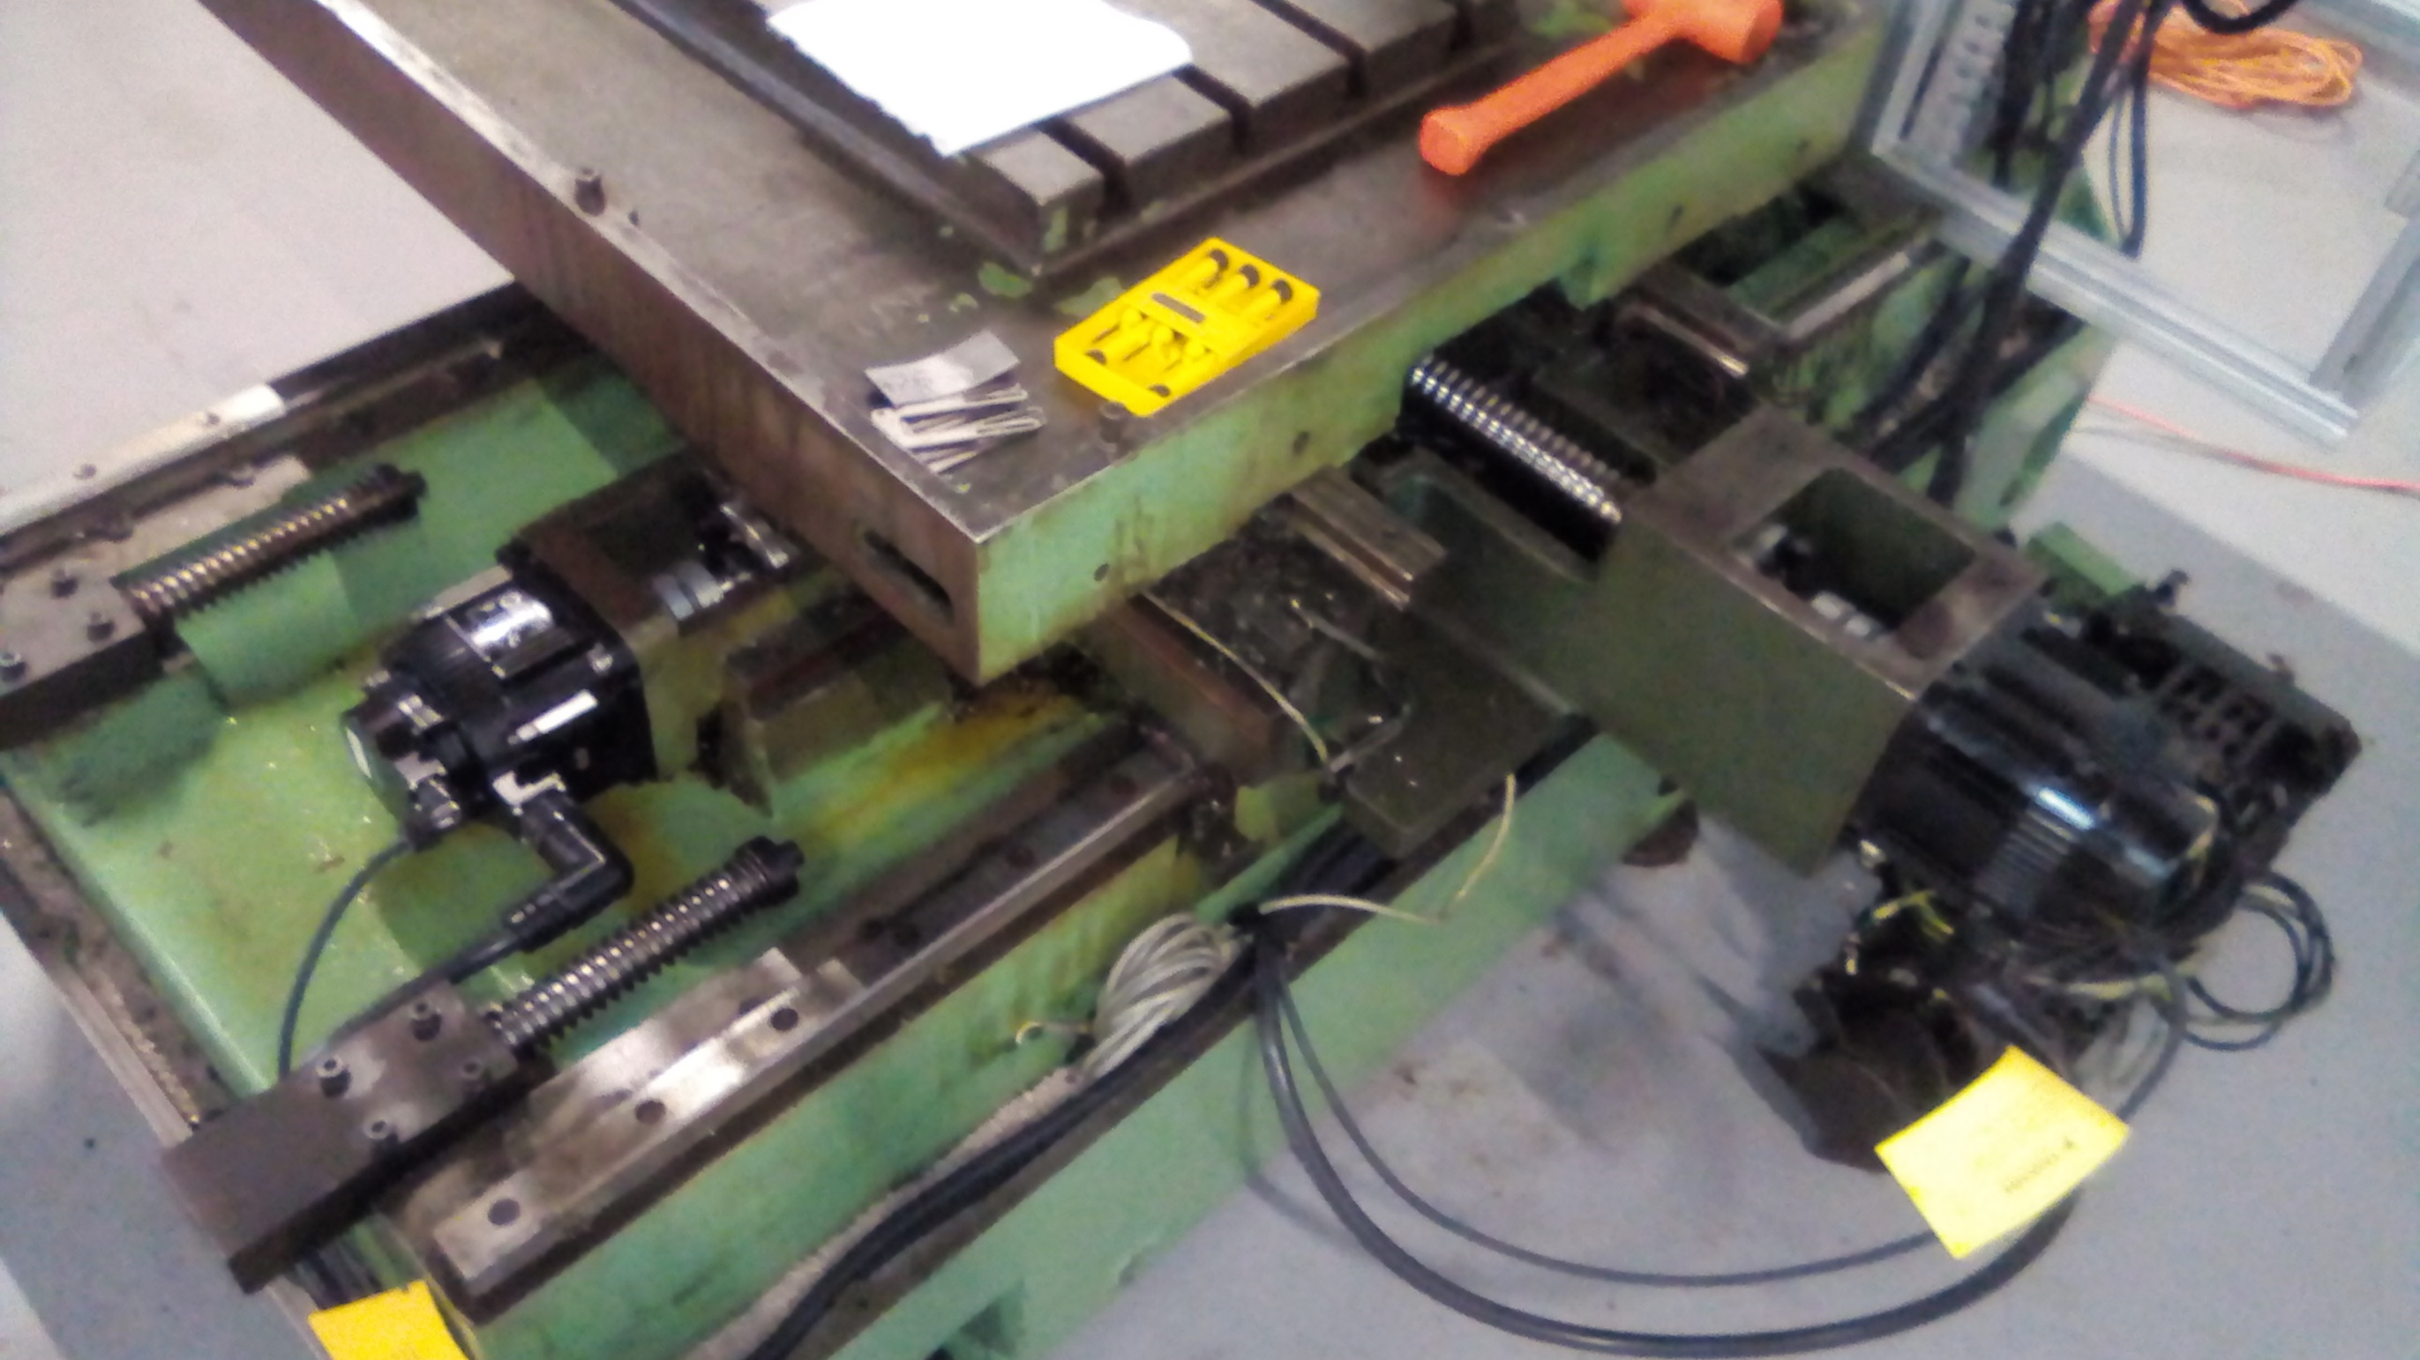
XYZ Drive Axes
Z axis ball screw
X & Y axis ball screws

Slide 8
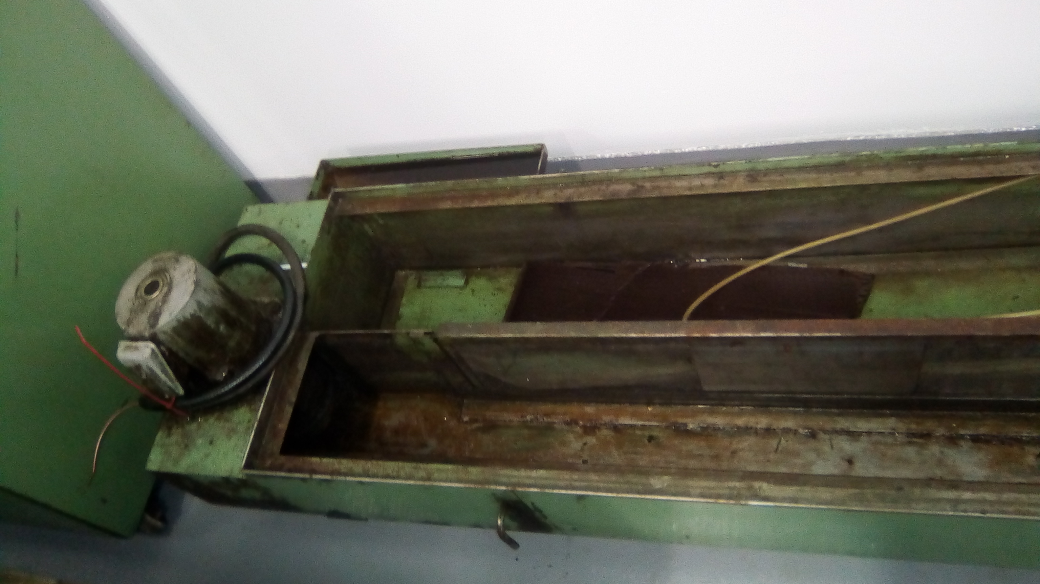
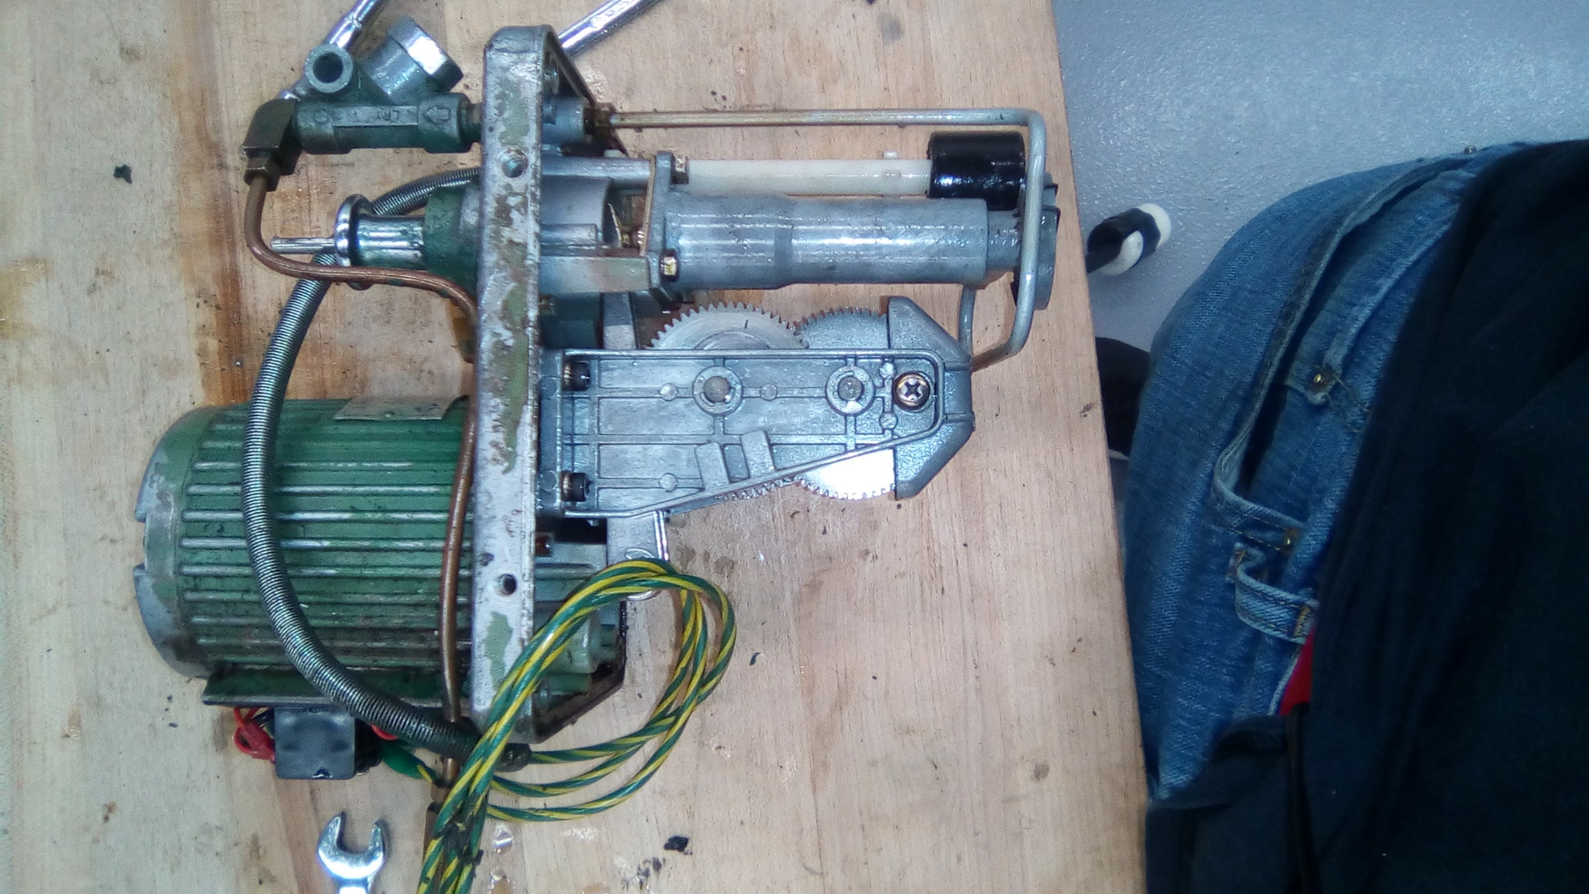
Lubrication & Coolant Pump
Lubricant
Coolant

Slide 9
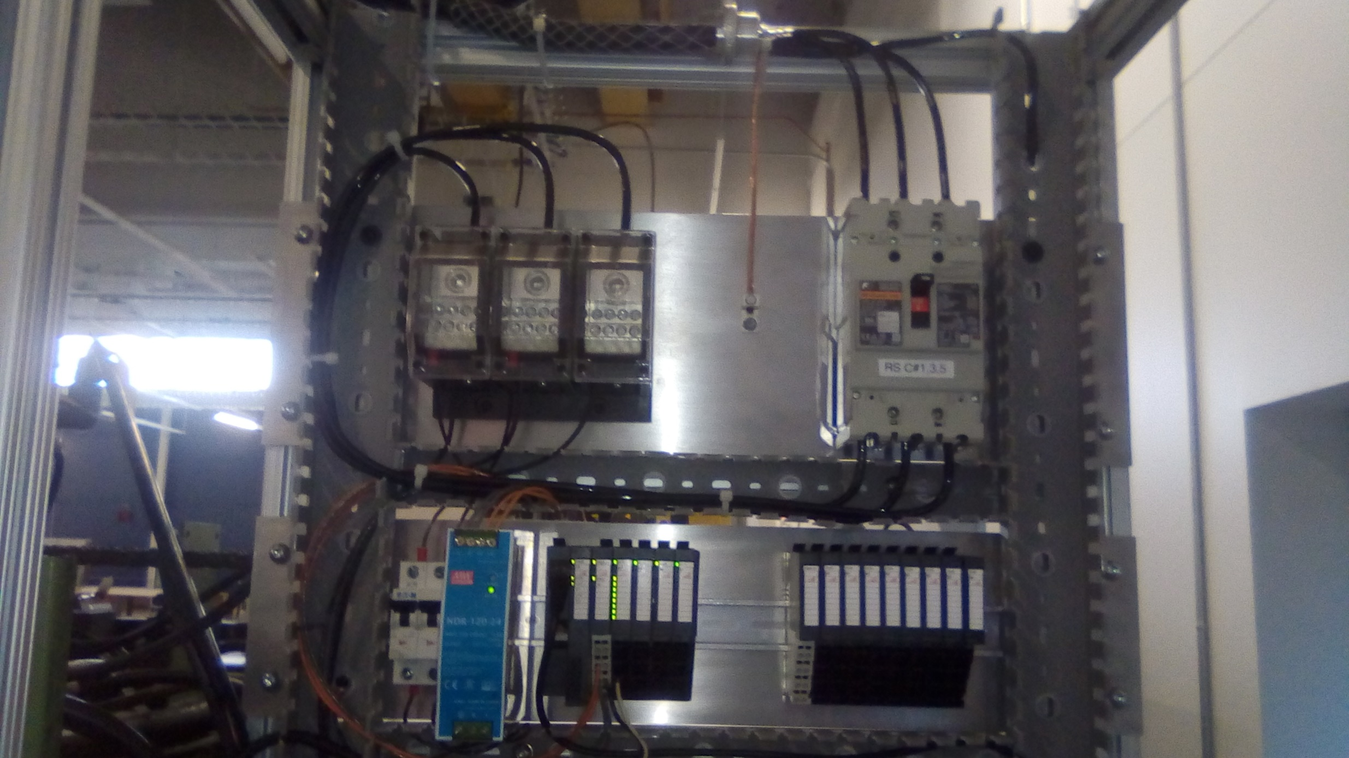
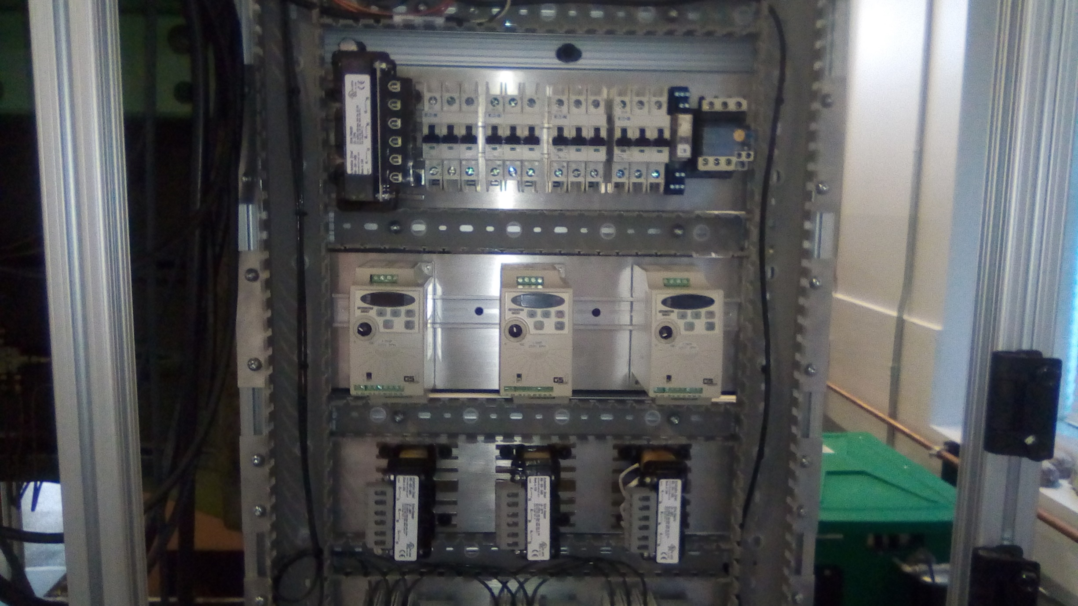
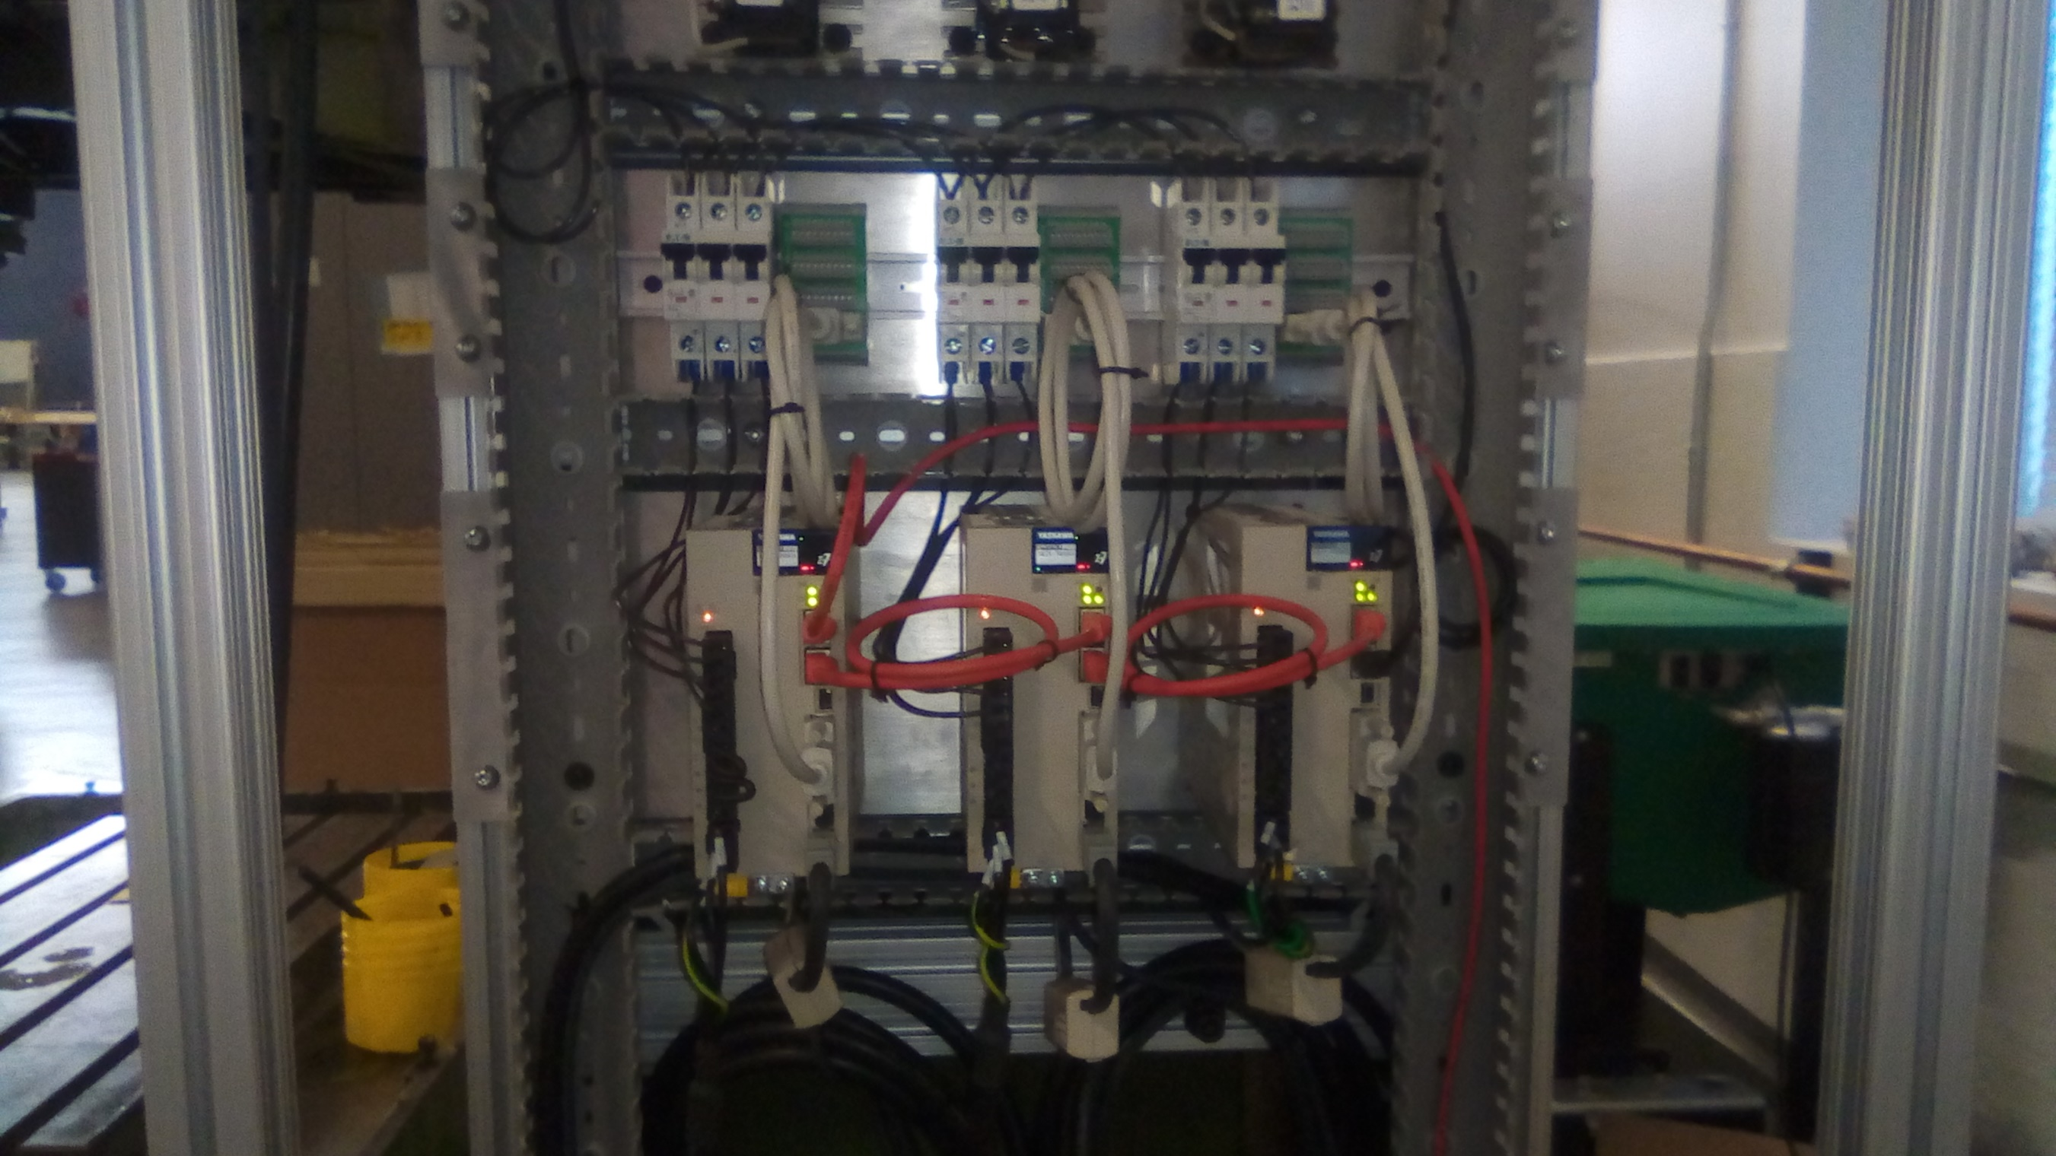
Electrical Power System
Power & IO
Induction Drives
Servo Drives

Slide 10
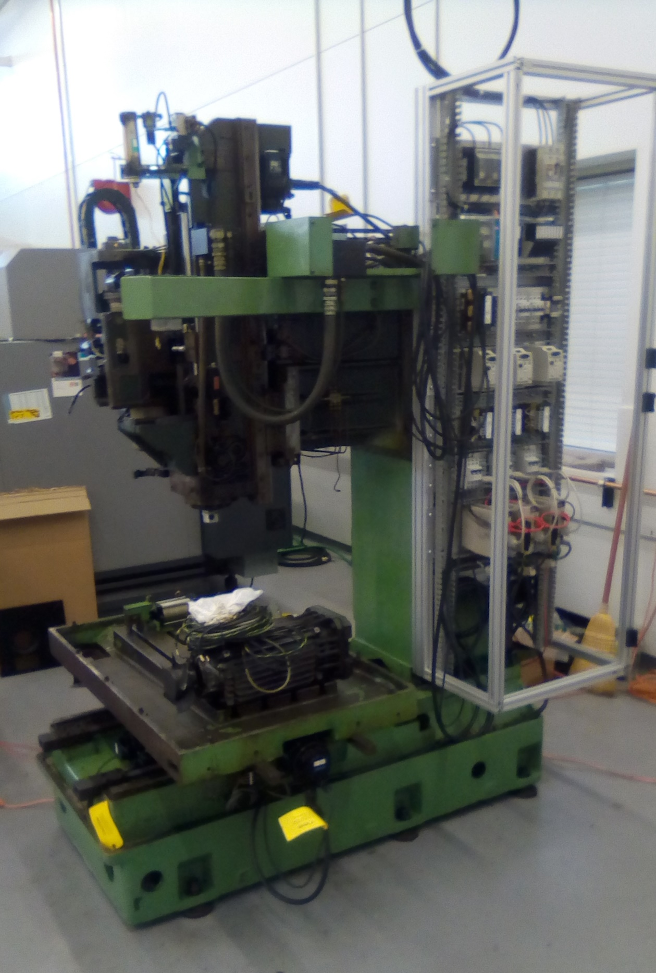
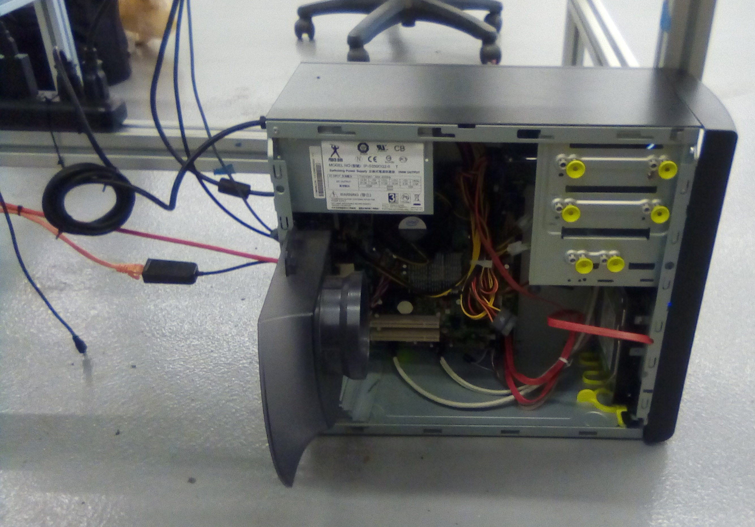
Power System & Controller
Control computer
Real time patch
EtherCAT master patch
USB – Ethernet adapter
Control cabinet

Slide 11
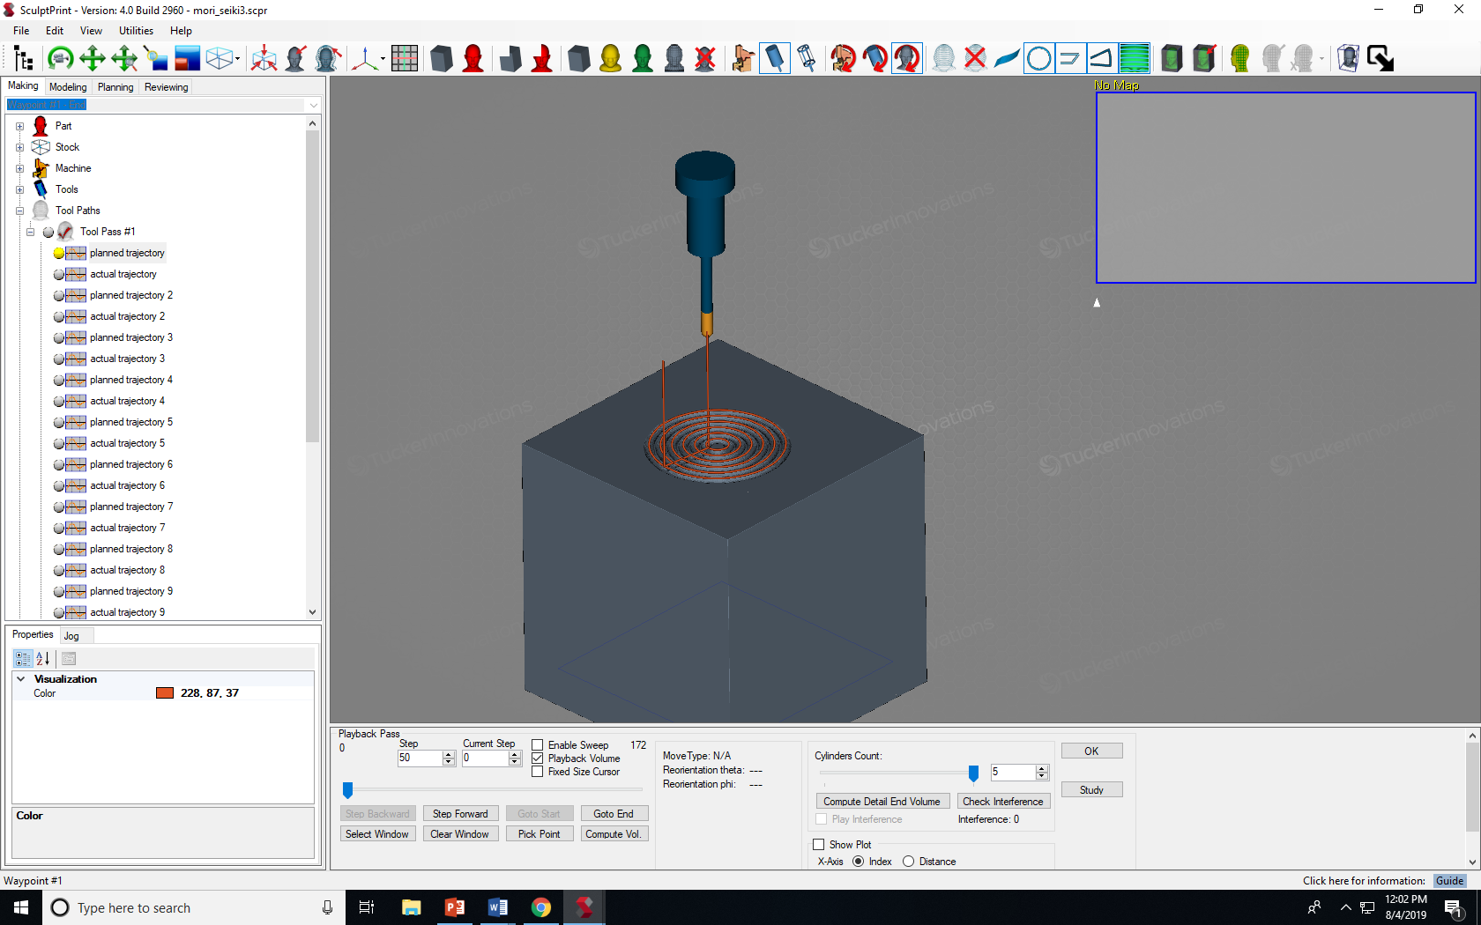
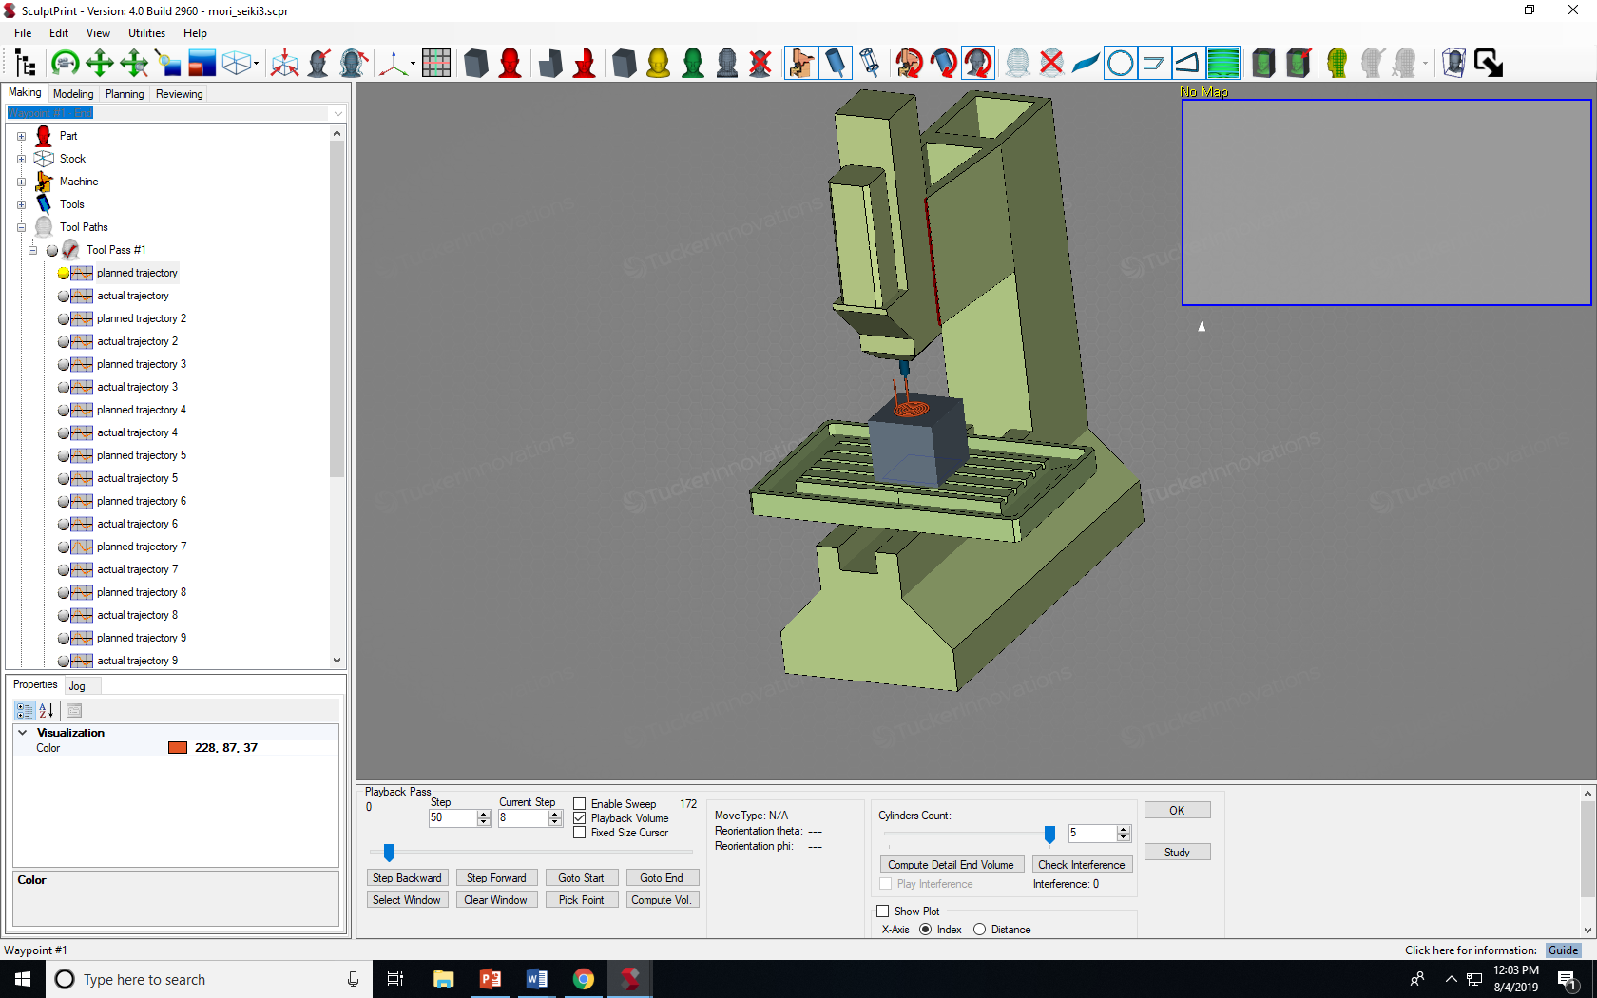
SculptPrint CAM & Digital Twin
plan
Machine
Hardware
feedback
CAM generated tool path
Machine model

Slide 12
Software/Firmware
CAM Computer
Control Computer
Machine Hardware
SculptPrint
User Space
Kernel Space
EtherCAT
Linux Pipe
Xenomai Real Time
Digital Twin
TOPPRA Interface
CAN bus
Servos
Socket
Loopback Socket
IgH Master
Interface
GUI
IO Rack
Application Code

Slide 13
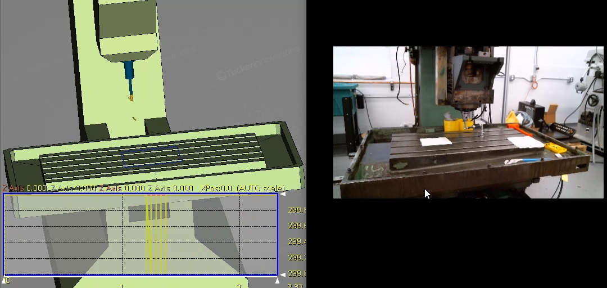
CAM Integration Results
Machine drives CAM
CAM drives Machine

Slide 14
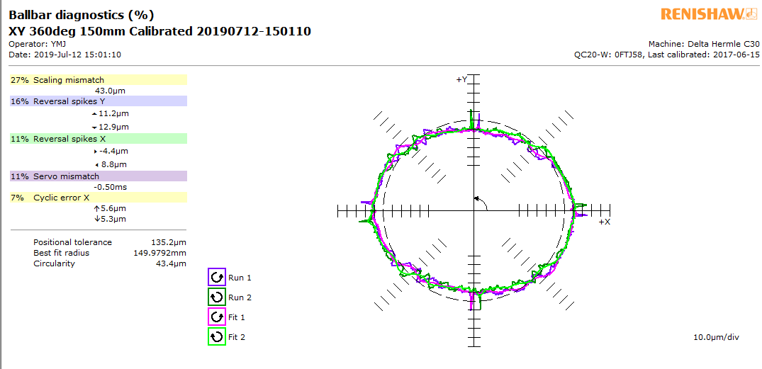
Experimental Verification
Positional tolerance:
135.2 um

Slide 15
Summary
1. Inexpensive, open architecture hardware update
2. Higher level control and monitoring software
3. Experimental verification
Facilitates highly automated, lean, distributed manufacturing

Slide 16
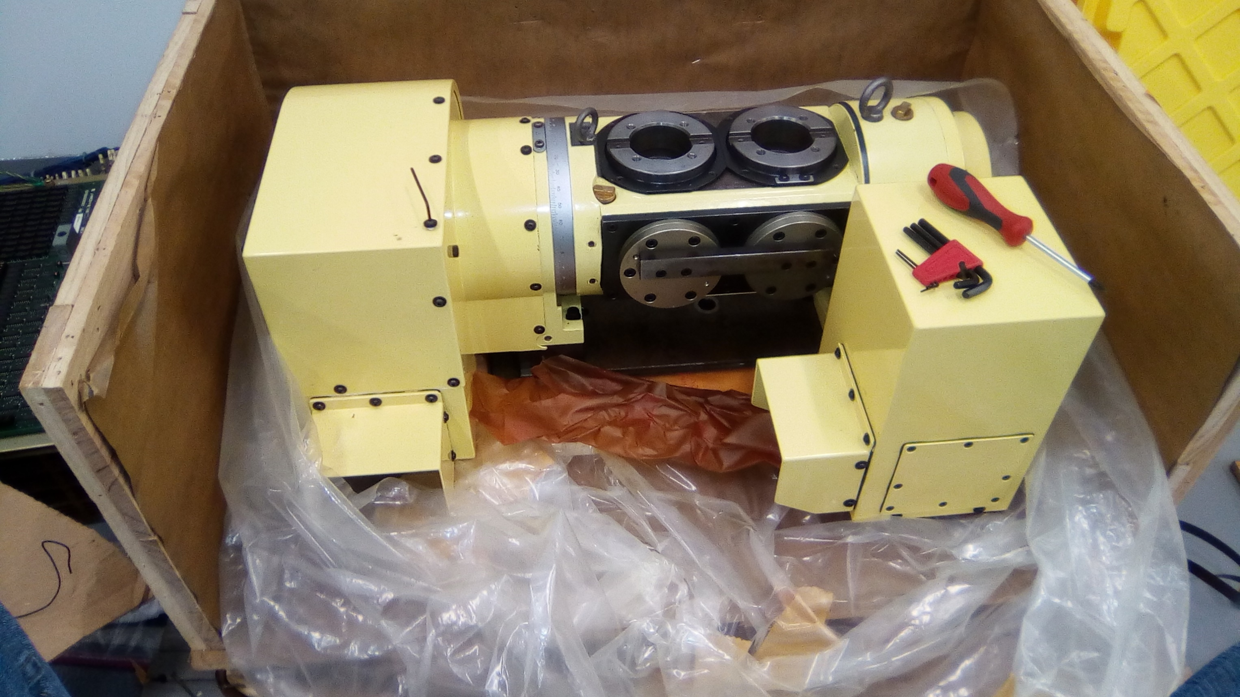
Next steps
Add 4th & 5th axis

Slide 17
RACECAR Navigation & Control
Kyle Williams
Georgia Institute of Technology
Atlanta, Georgia USA
August 8, 2019
Notes:
Good afternoon, and other greetings.

Slide 18
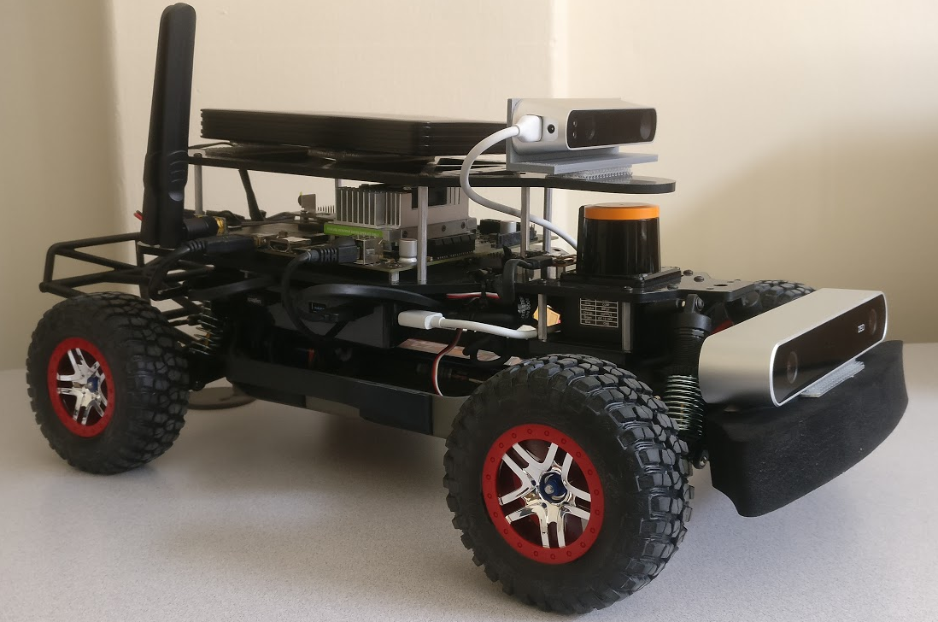
Introduction
RACECAR research platform

Slide 19
Goals
Setup sensors and controllers in ROS
Test & integrate autonomy algorithms
SLAM
non holonomic control
path planning
Autonomous navigation from A to B in a cluttered environment

Slide 20
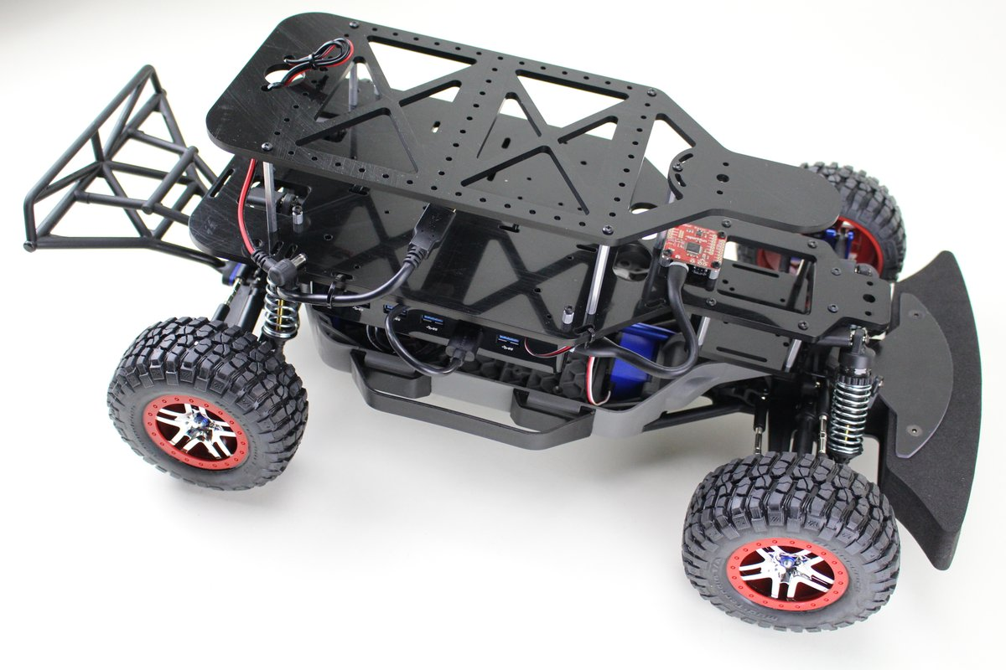
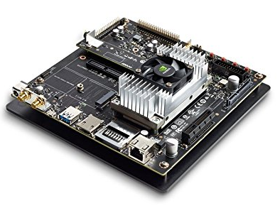
Mechanical & Computational Platform
RACECAR J Hardware
NVidia Jetson TX2

Slide 21
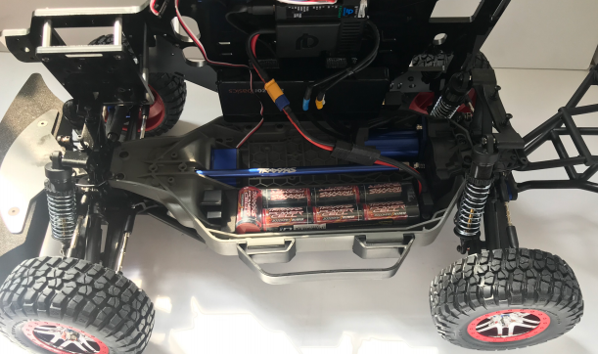
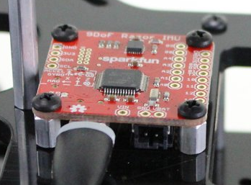
Velocity & Acceleration Sensors
Controller
Steering servo
BLDC
drive motor
9 DoF IMU

Slide 22
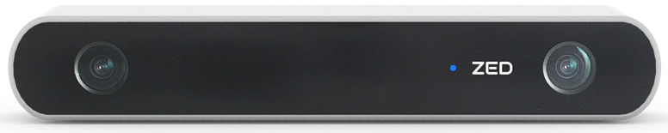
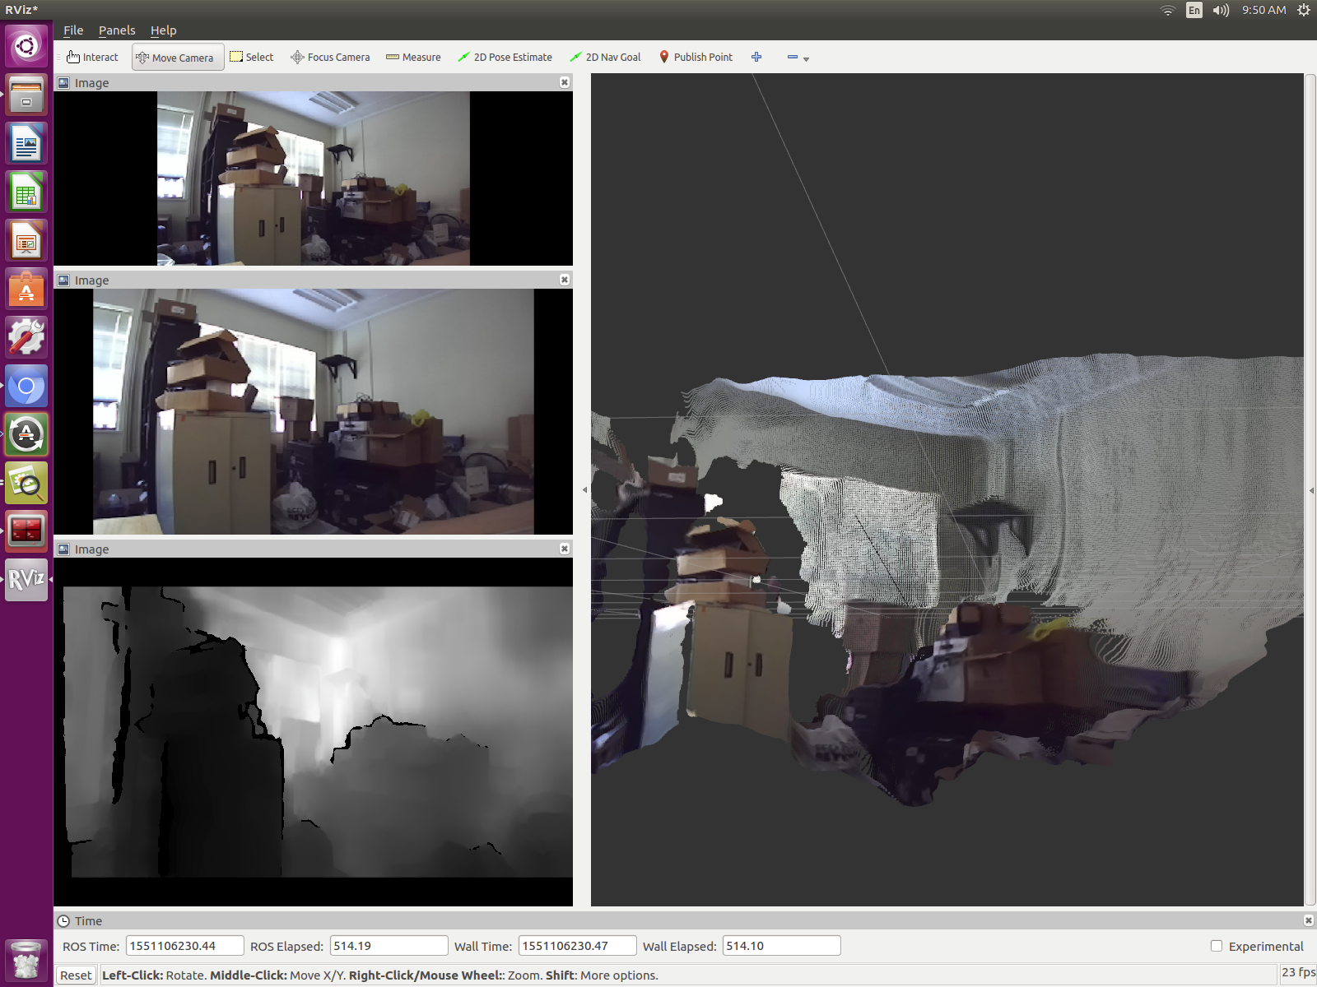
ZED Stereo Camera
Depth Image
4D Reconstruction

Slide 23
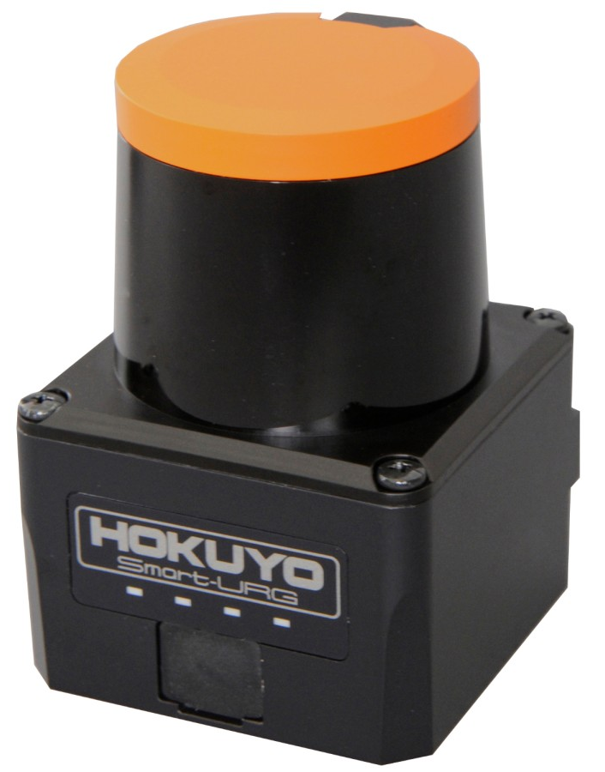
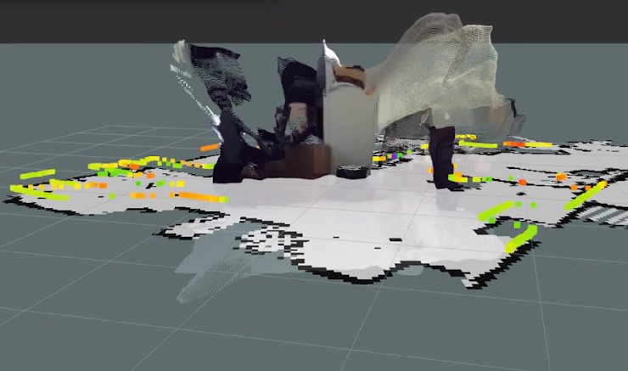
Hokuyo Lidar
Planar range data

Slide 24
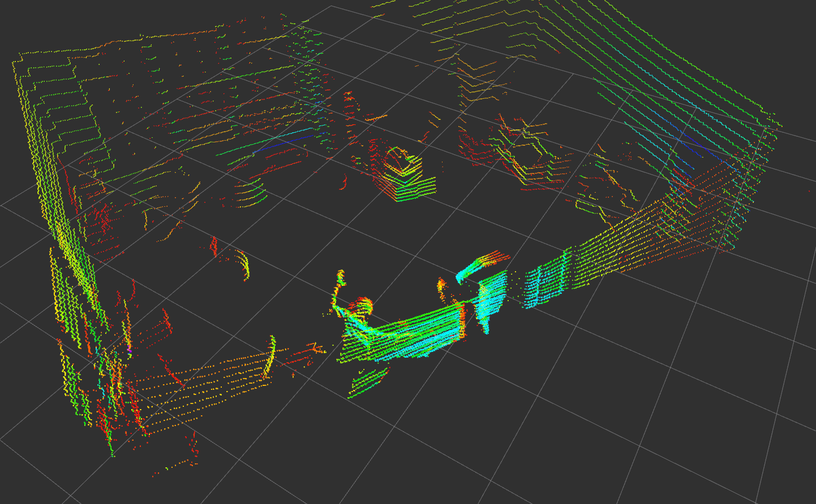
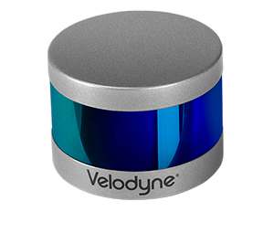
Velodyne Lidar
3D Range Data

Slide 25

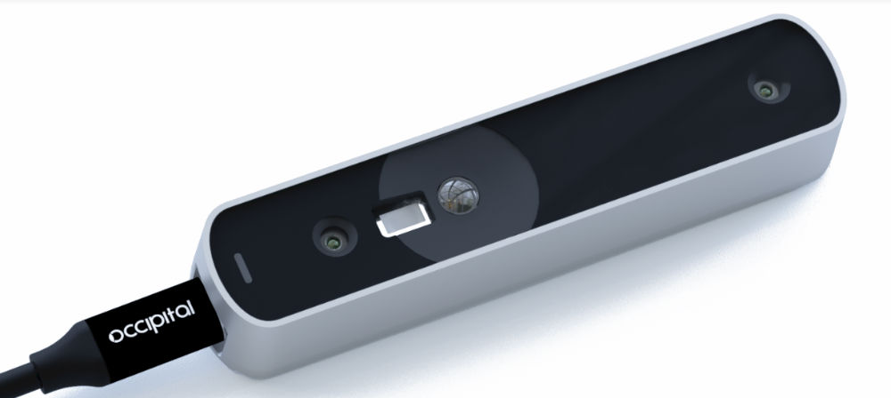
Occipital Structure Sensor
IR Depth Image

Slide 26
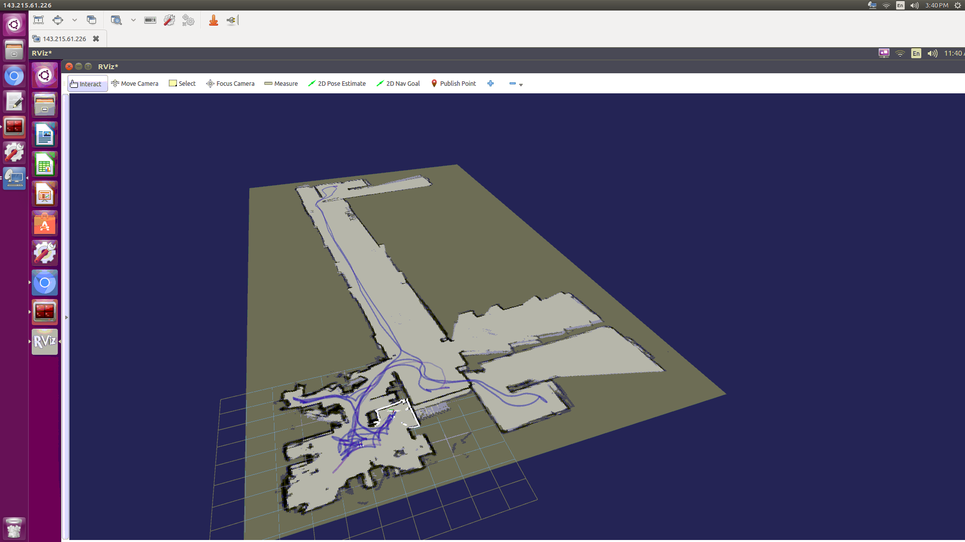
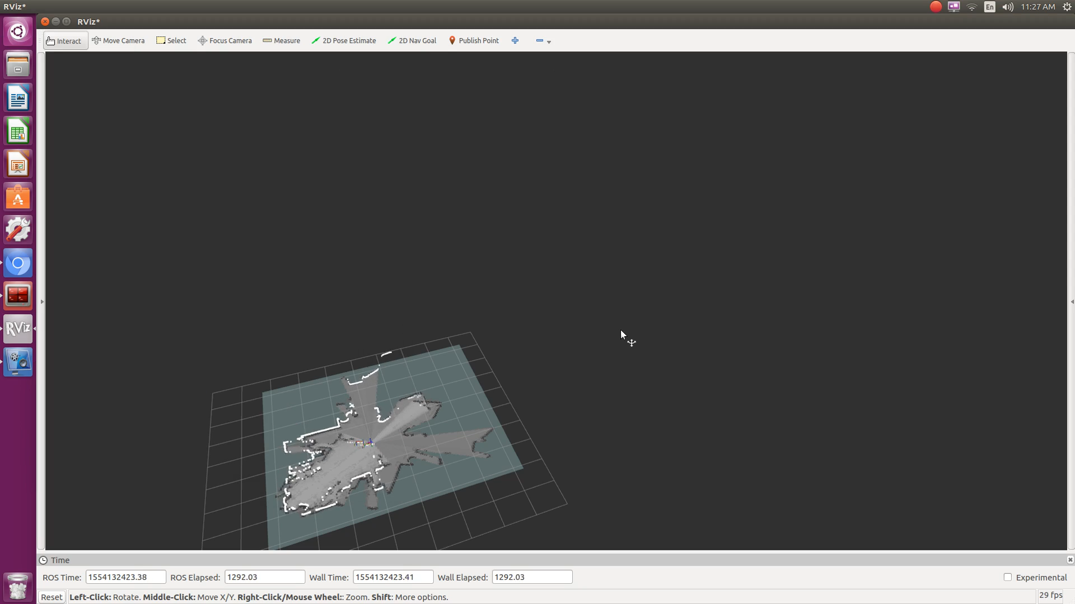
Google Cartographer SLAM
Mapping Process
2D Hallway Map

Slide 27
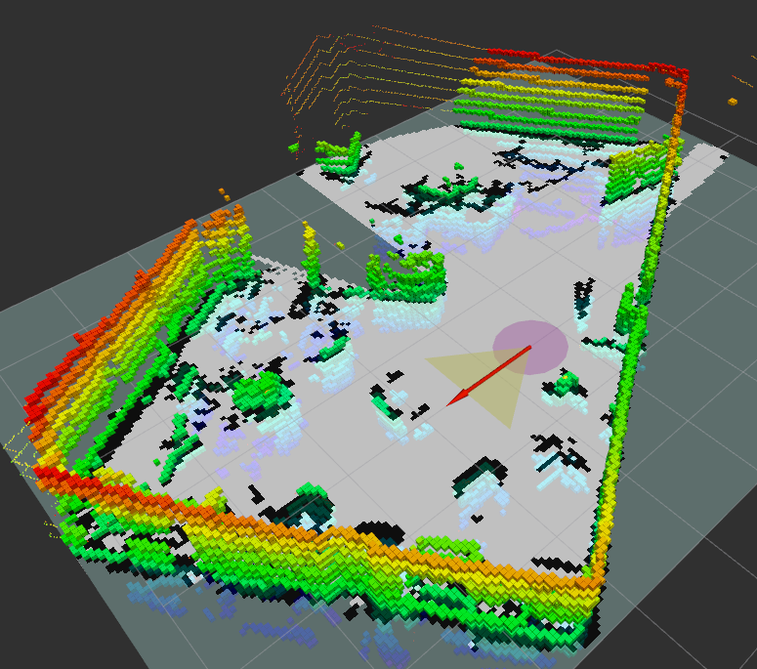
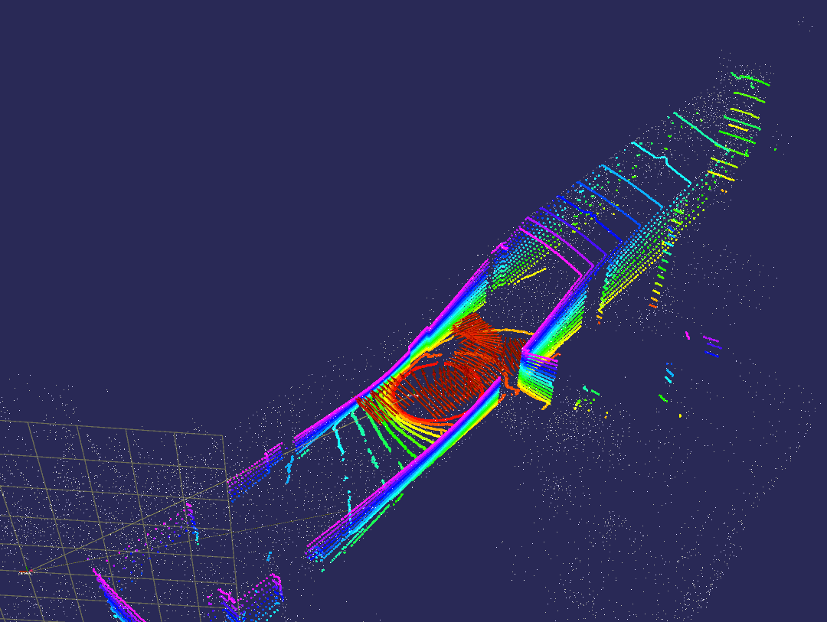
3D Octomapping & LOAM
3D Octomapping
3D LOAM

Slide 28
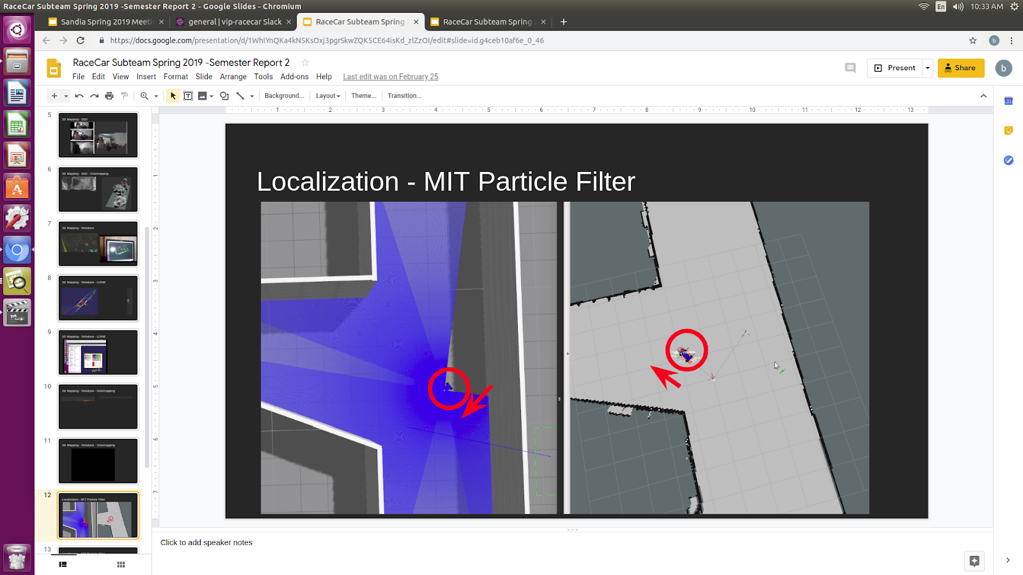
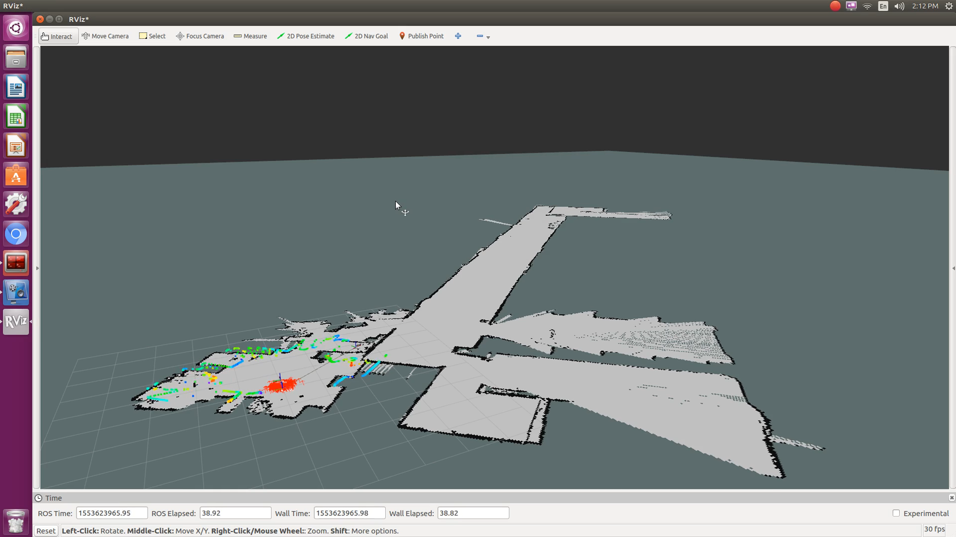
Particle Filter Localization
Failed localization in simulation
Adaptive Monte Carlo Localization on hardware

Slide 29
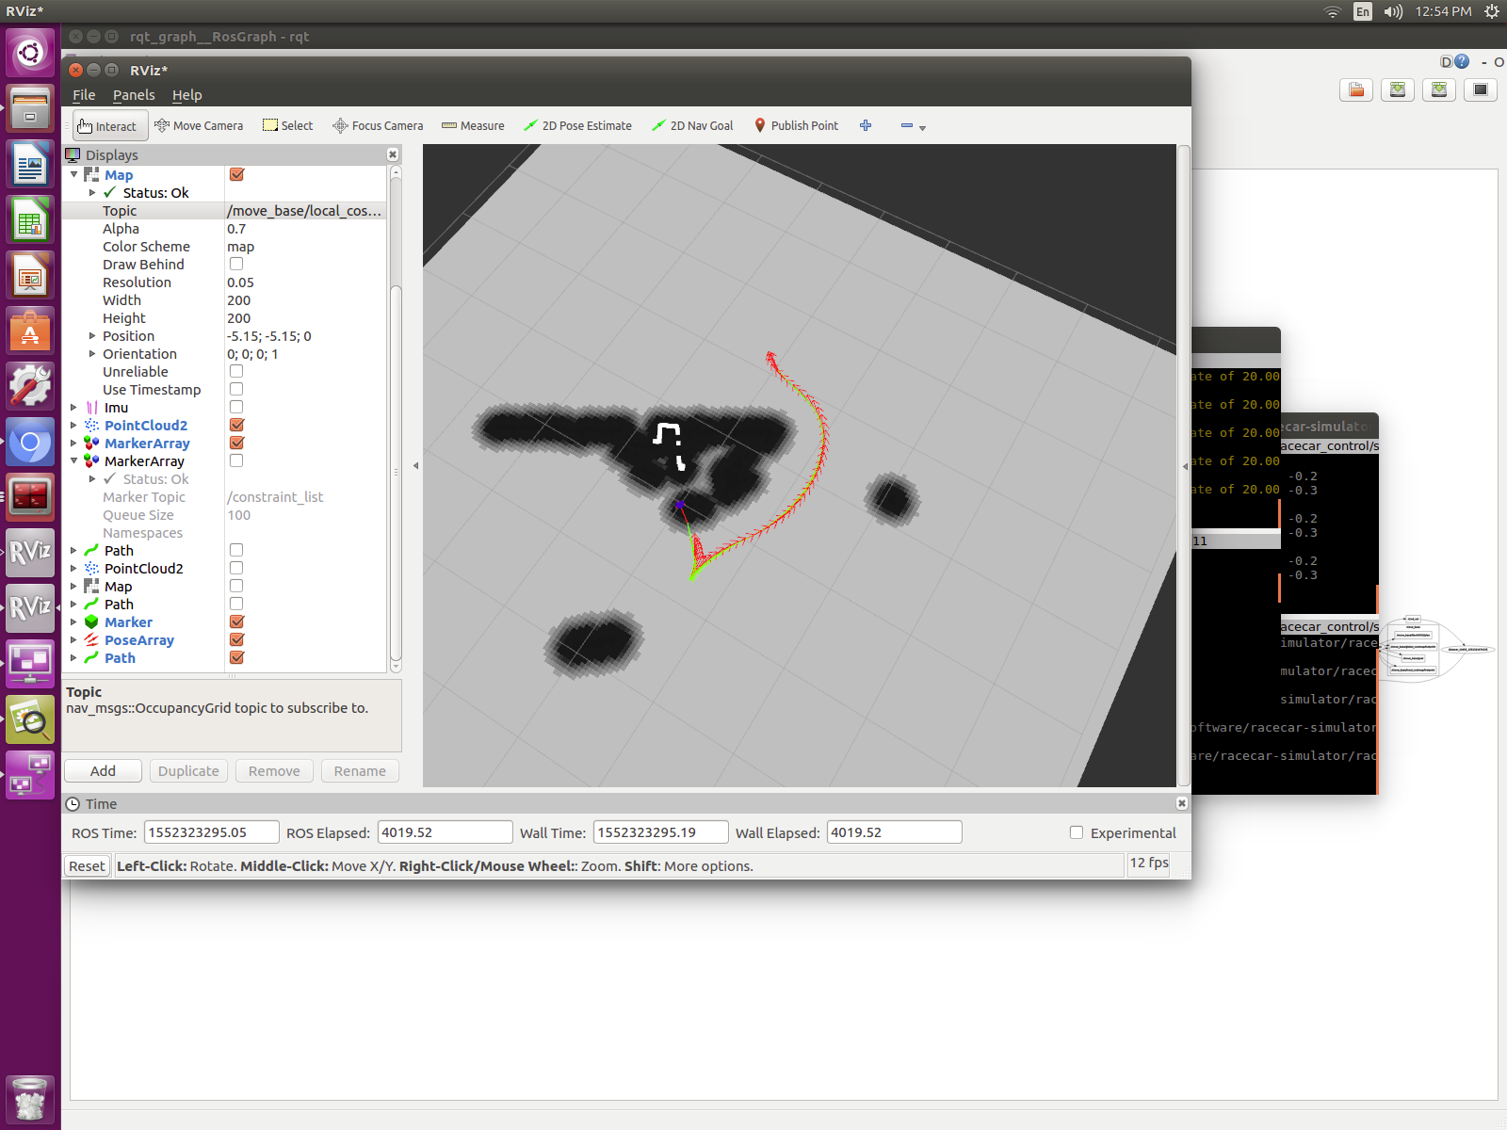
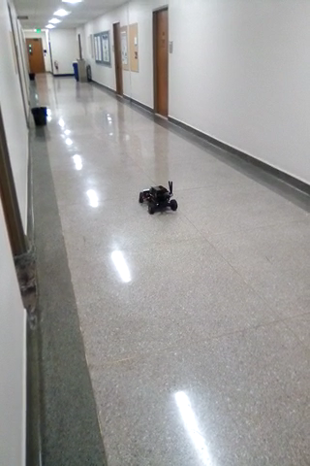
TEB Non holonomic control
Timed Elastic Band trajectory planning
Autonomous Reversal

Slide 30
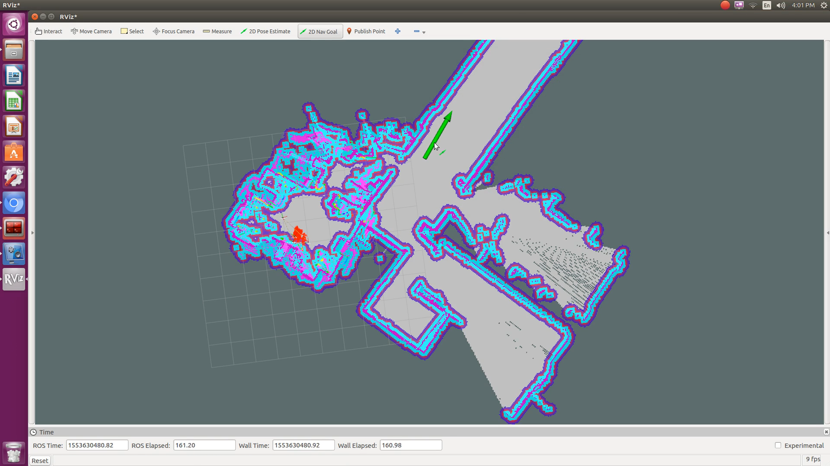
A* Path Planning & Full Stack Navigation
Mapped environment
Localization
High level planning
Low level control

Slide 31
Summary
Integrated sensing, actuation & computation in ROS
Integrated mapping / SLAM / localization
Integrated path planning & control
Executed autonomous navigation from A to B

Slide 32
Next Steps
More rigorous testing environments and better benchmarking
Better use of GPU
Improved 3D mapping
Model predictive control and more aggressive driving
Deep learning for control or classification

